Slide 1
Religion
Meaning and definition
Human being as spiritual being too.
A means of social control, that guides man’s behavior spiritually.
So revolves round the man’s faith in the supernatural forces.
Sociology on religion does not study in the matter of god’s emergence and its omnipotent and omnipresent existence, but it studies on the impact of religion on peoples’ various aspects of life.

Slide 2
Religion
Meaning and definition
Closely related to morality
The concept of ‘sacred’ and ‘Profane’
Emergence of religion- ‘fear theory’ and d
MacIver and Page- ‘The relationship between not only man and man but also between man and supernatural being’.
No exact date and space of origin of religion
Different impact of religion on different societies

Slide 3
Religion
Meaning and Definition
Functions of religion
Dysfunction of religion
Features of religion
The concept of secular society and secularization.

Slide 4
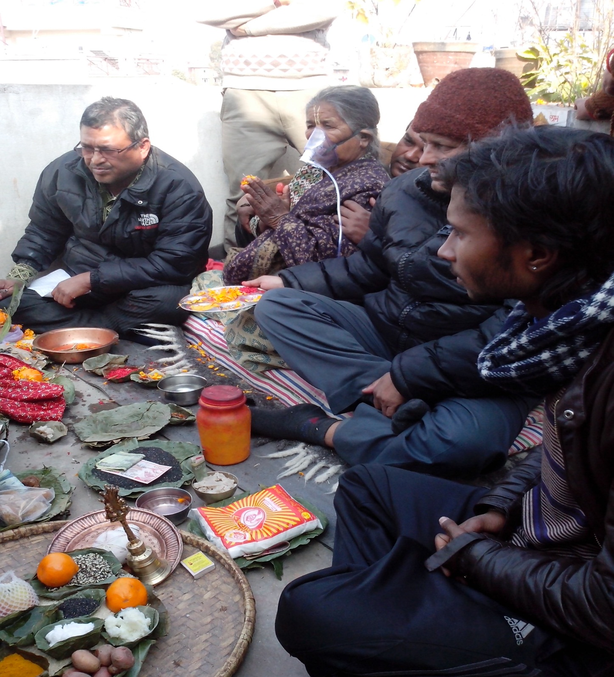
Religion
Features
Notes:
One of the ritual practices that is made just before one’s possible death in order to supposedly send him/her to the imagined heaven (salvation ritual under Hinduism)

Slide 5
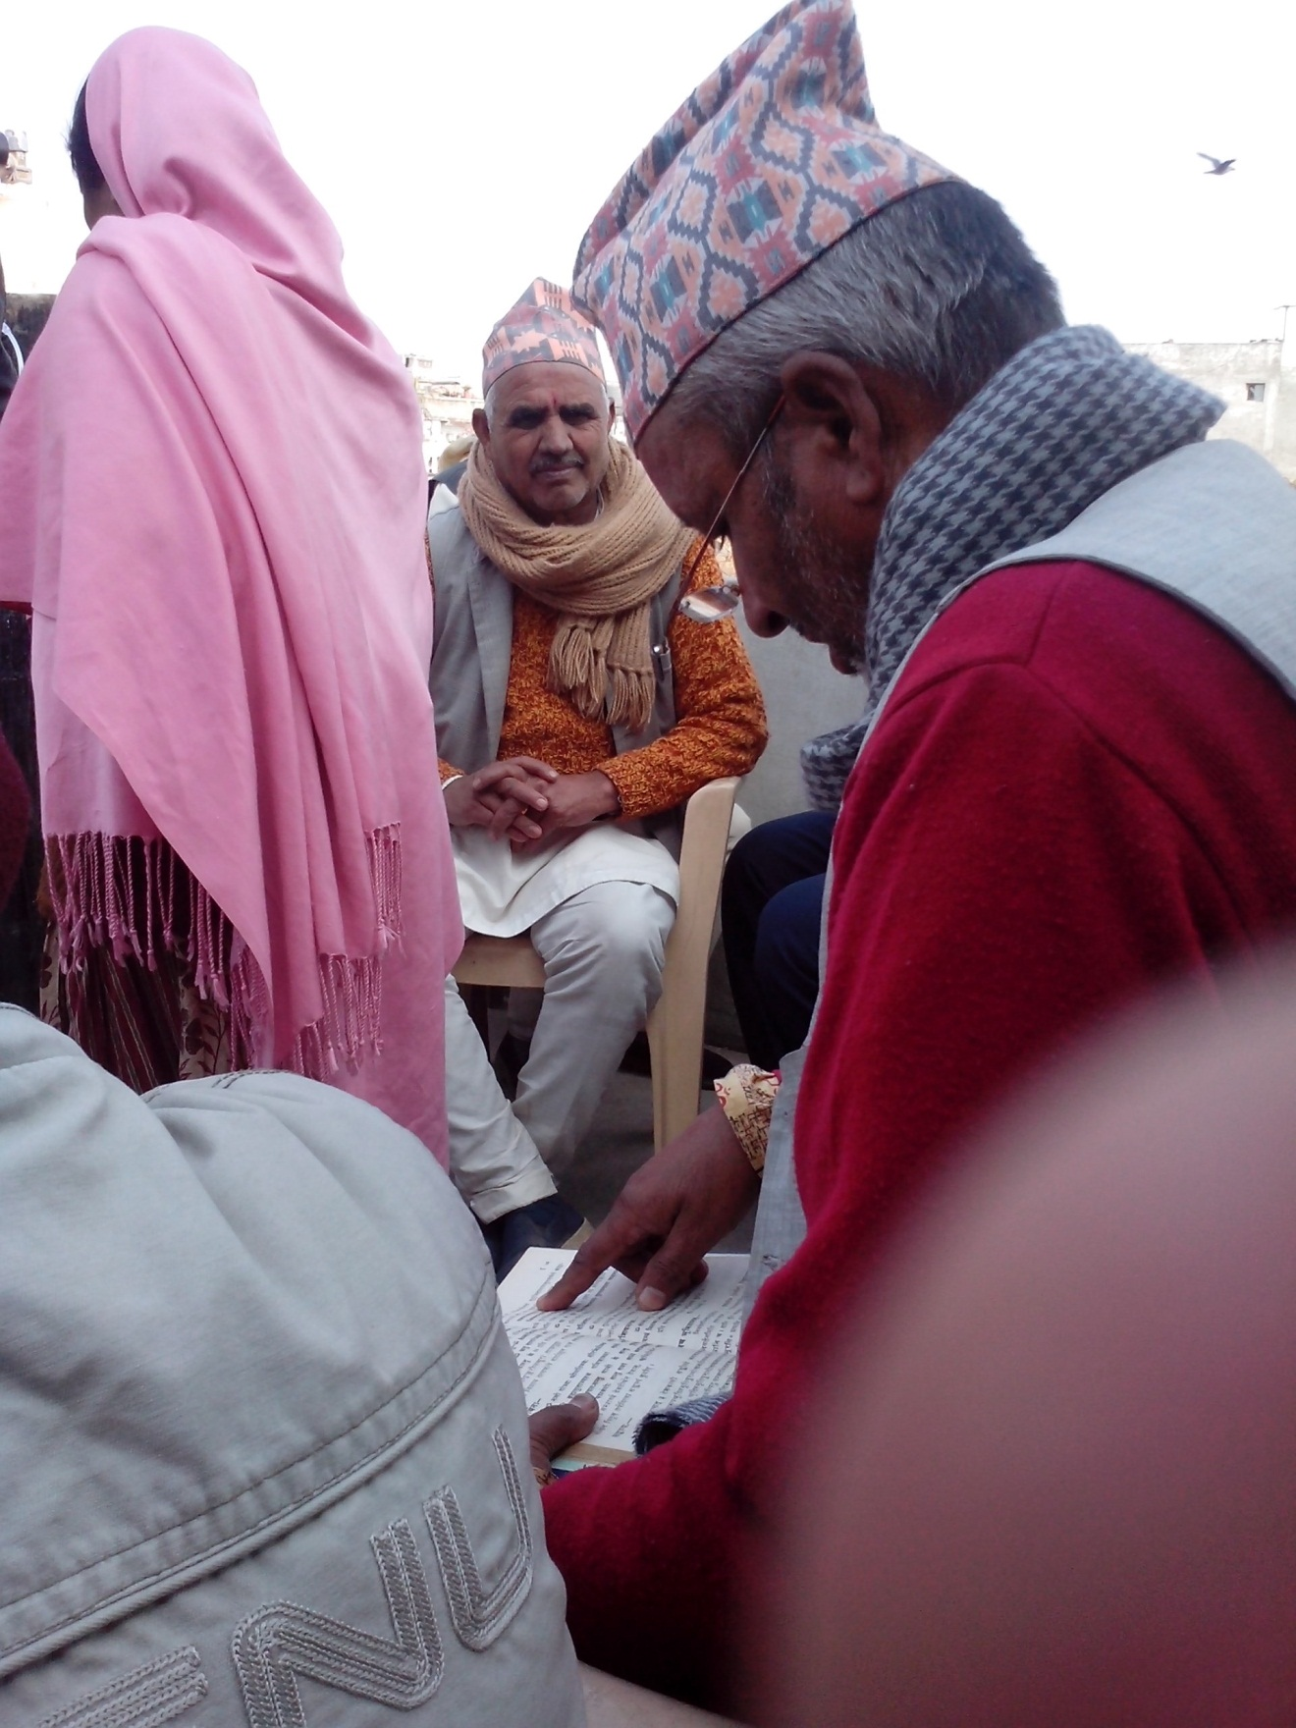
Religion
Hinduism is such a religion under which numerous ritual practices are performed during one’s whole life cycle.
Notes:
Brahmans involved into the performance of salvation ritual (known as Baitarni Tarne)

